Slide 1
Restful API

Slide 2
Table of contents
1/ What is RESTful API?
2/ Resource in REST
3/ How it works?
4/ HTTP methods
5/ HTTP request
6/ HTTP response
7/ Status code
8/ Pros and cons

Slide 3
What is RESTful API?
API (Application Programming Interface) is a software intermediary that allows two applications to talk to each other
REST (REpresentational State Transfer) is web standards based architecture and uses HTTP Protocol
REST revolves around resource where every component is a resource and a resource is accessed by a common interface using HTTP standard methods.

Slide 4
Resource in REST
A resource in REST is a similar Object in Object Oriented Programming or is like an Entity in a Database
REST provides access to resources and allows to modify resources
REST uses various representation to represent a resource like text, JSON, XML. JSON is the most popular one.

Slide 5
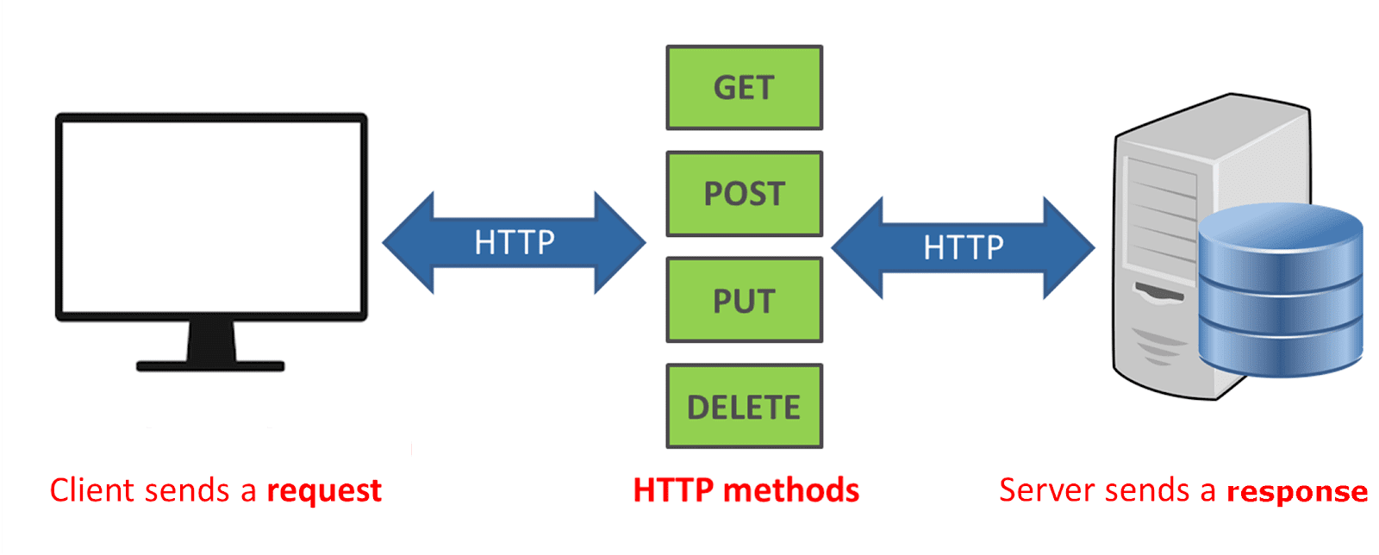
How it works

Slide 6
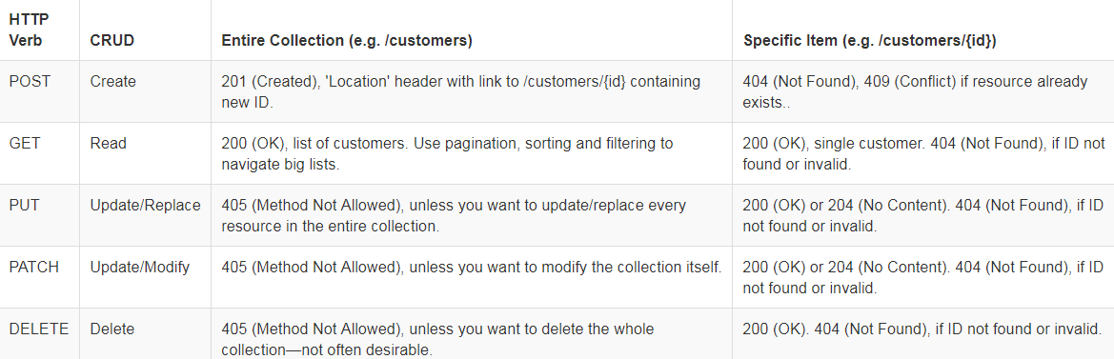
HTTP methods

Slide 7
HTTP Request
An HTTP Request has five major parts −
Verb − Indicates the HTTP methods such as GET, POST, DELETE, PUT, etc.
URI − Uniform Resource Identifier (URI) to identify the resource on the server.
HTTP Version − Indicates the HTTP version. For example, HTTP v1.1.
Request Header − Contains metadata for the HTTP Request message as key-value pairs. For example, client (or browser) type, format supported by the client, format of the message body, cache settings, etc. (example: User-Agent: Mozilla/5.0)
Request Body − Message content or Resource representation.

Slide 8
HTTP Response
An HTTP Response has four major parts −
Status/Response Code − Indicates the Server status for the requested resource. For example, 404 means resource not found and 200 means response is ok.
HTTP Version − Indicates the HTTP version. For example HTTP v1.1.
Response Header − Contains metadata for the HTTP Response message as keyvalue pairs. For example, content length, content type, response date, server type, etc. (example: Content-Type': 'application/json')
Response Body − Response message content or Resource representation.

Slide 9
Status code
* 200 OK - Successful return for methods GET, PUT, PATCH or DELETE.
* 201 Created - Returns when the Resource has been successfully created.
* 204 No content - Returns when the resource was deleted successfully.
* 304 Not modified - Customer may use cached data.
* 400 Bad request - The request was invalid
* 401 Not allowed - Require authentication.
* 403 Forbidden - denied license.
* 404 Not Found - No resource found from URI
* 405 Method not allowed - This method is not allowed for the current user.
* 410 Gone - Resource no longer exists, older version no longer supports.
* 415 Unsupported media type - Does not support this Resource type.
* 422 Entity could not process - Data not authenticated
* 429 Too many requests - The request was denied due to restrictions

Slide 10
Pros and cons
Pros:
- Simplicity
- lower maintenance costs
- great flexibility
- high scalability
-
Cons:
- Rest can work on only HTTP protocol only
- Less security, not suitable for distributed environments.

Slide 11
References
https://www.restapitutorial.com/
https://www.tutorialspoint.com/restful/

